Slide 1

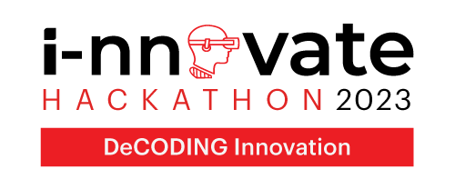
love the new
iSense:
Enabling Independent Navigation for the Visually Impaired

Slide 2
Team Details
Team Name | Member Names | Education Institute Name
Corporate Visionaries | Ruchita Raut | Intelliswift Software, Inc.
 | Shekhar Hippargi | Intelliswift Software, Inc.

Slide 3
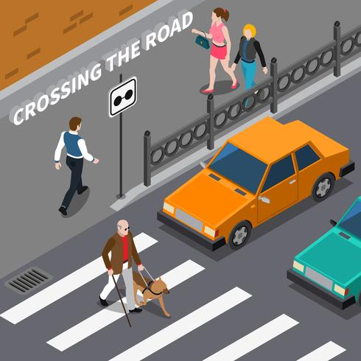
Problem Statement
According to NIH India (nih.gov), there are an estimated 4.95 million people blind (0.36% of the total population), 35 million people visually impaired (2.55%), and 0.24 million blind children in India. ​
The problem faced by blind individuals revolves around obstacles in daily living due to the absence or limitation of sight. This includes difficulties in navigation, accessing information, performing routine tasks independently, and experiencing challenges in various environments without visual assistance.

Slide 4
What is your idea for the solution?
The aim of this project is to develop a comprehensive assistive low-cost navigation system without using camera tailored for visually impaired individuals to safely and independently navigate urban environments. ​
The system will focus on aiding users in locating the nearest crosswalk and/or traffic signal, providing real-time navigation guidance to reach the designated crossing, and offering auditory cues to determine the status of the traffic signal (red or green) upon arrival.​
Here the Generative AI for voice assistant, the innovative tool aims to empower visually impaired individuals by providing seamless auditory guidance, real-time environmental descriptions, and intuitive assistance for daily tasks, enhancing their independence and navigation in the world around them and give human-like text response.

Slide 5
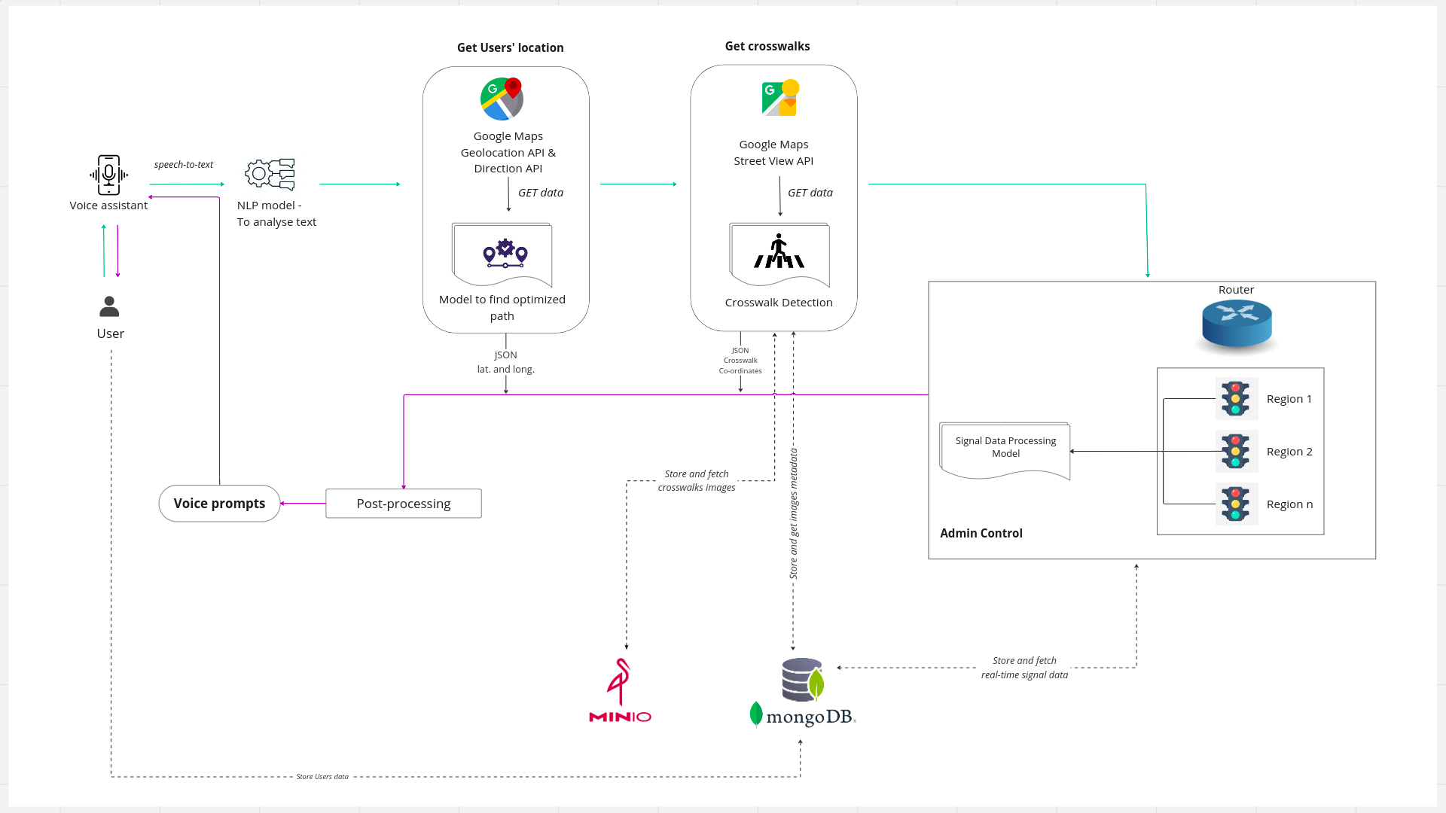
Architecture

Slide 6
Technologies Leveraged
Voice Assistant: To interact with user.​
Generative AI: To improve the quality of voice assistance and provide more natural-sounding responses.​
Google Maps Geolocation API: To get real-time location of user along with crosswalks.​
Google Maps Direction API: To get the optimized path from source to destination.​
Google Maps Street View API: To generate video of crosswalks along the optimized path detected.​
Computer Vision / Deep Learning: Developed Yolov8 model to detect crosswalks from the video.​
Python: To create custom REST APIs, to create deep learning model, manage workflow.​
MongoDB: To store users' data, Store Signal data, and metadata of images generated from Street View API.​
MinIO: It is an open-source High-Performance Object Storage. Here, we are storing images. Alternatives of MinIO are GCP's Cloud Storage and Amazon S3.

Slide 7
DEMO

Slide 8
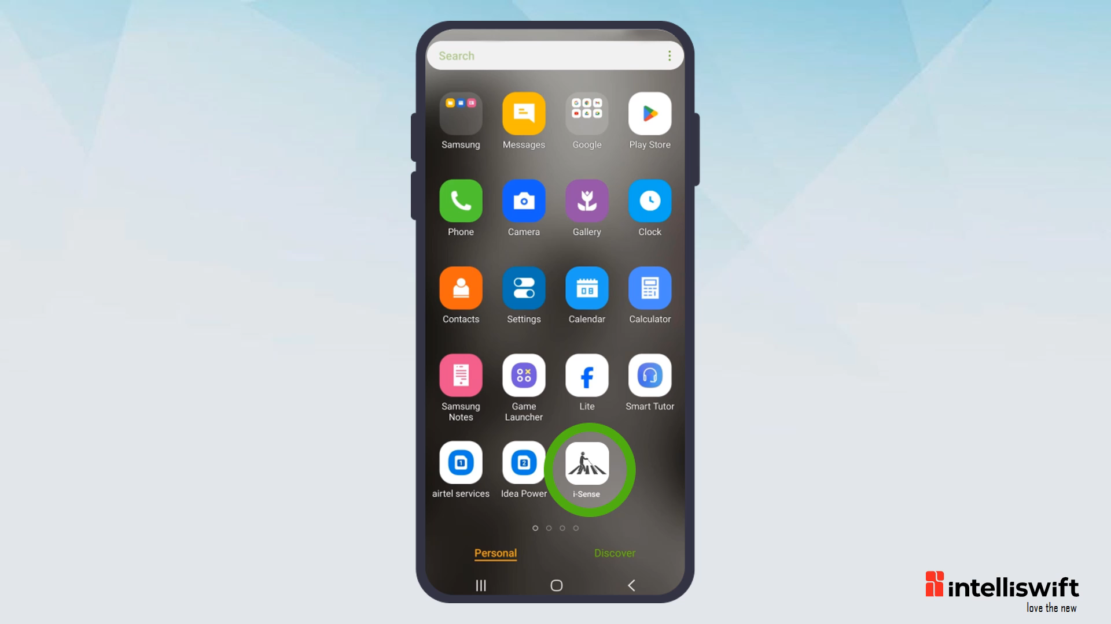

Slide 9
What domains does it address? What is the impact?
Our idea addresses multiple domains crucial for the accessibility and safety (Social Welfare) of visually impaired individuals.
Firstly, it tackles the domain of mobility and navigation by providing real-time guidance to locate and reach crosswalks and traffic signals. This significantly enhances their ability to move independently, reducing reliance on external assistance.
Additionally, the system addresses the domain of sensory perception by offering auditory cues to discern the status of traffic signals, overcoming a significant challenge faced by visually impaired individuals
This solution has a profound impact on the independence, safety, and confidence of visually impaired individuals, empowering them to navigate urban environments with greater ease and security.

Slide 10
Financial Feasibility
While the implementation of such a system can incur initial development and operational costs, it also holds potential for sustainable revenue generation and positive societal impact.
Initial Development Costs: Most of the open-source technologies like Machine Learning models, Google Maps APIs, Python, Mobile Apps will be used to develop the solution. The minimal costing will be for Vision API and deployment of the solution.
Revenue Streams: This includes sales of assistive devices or mobile apps, subscription models, licensing technology to other entities (NGOs / Trusts), or partnerships with municipalities and Government organizations.
Monetization Strategy: The strategy for the ROI can be gained by incorporating subscription tiers with estimated minimal costings potential revenue-sharing agreements with partners.

Slide 11
Resources
Prototype GitHub Link:-
https://github.com/shekhar-hippargi/Hackathon-CorporateVisionaries

